Slide 1
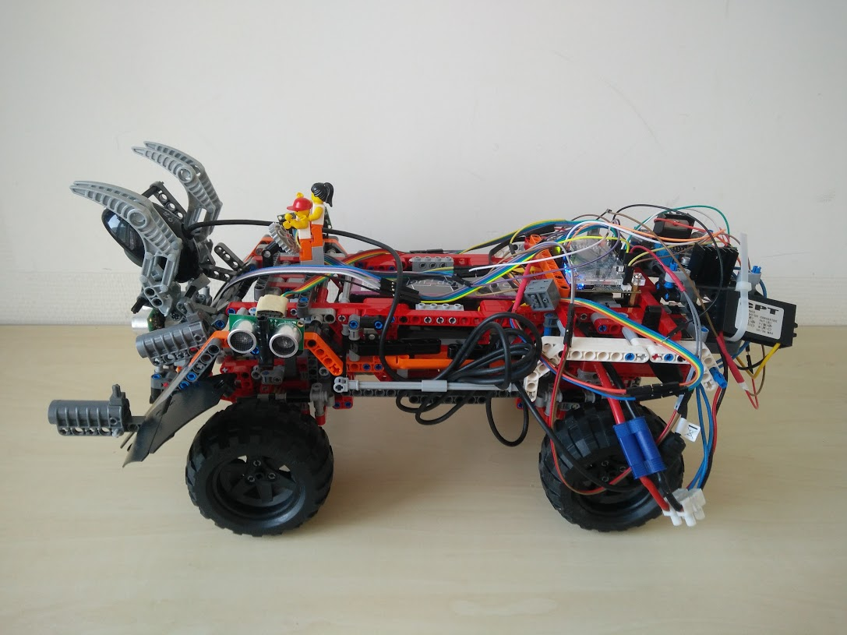
Hardware & Wiring

Slide 2
Hardware
Components
Controll
- DE0-Nano Board
- Raspberry Pi 3
Actuators
- Steering Servo Motor
- Drive Motors
Sensors
- KS103 Ultrasound Sensor
- Camera
Power Supply
- Battery
- H-Bridge
- CPT 15W DC/DC Converter

Slide 3
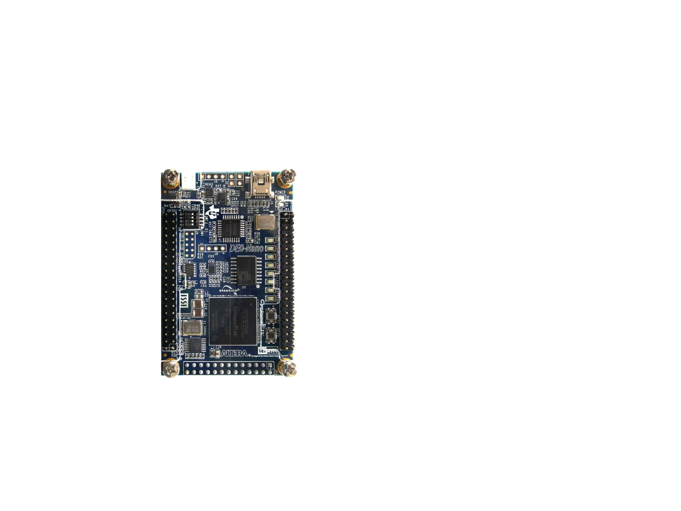
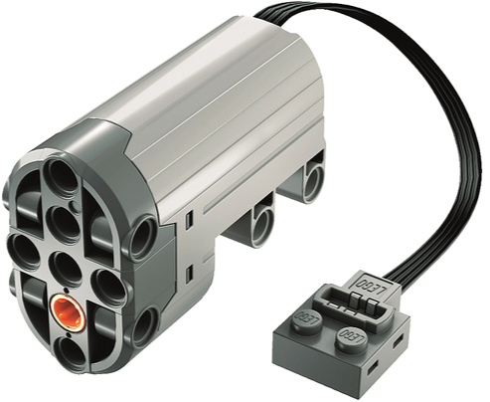
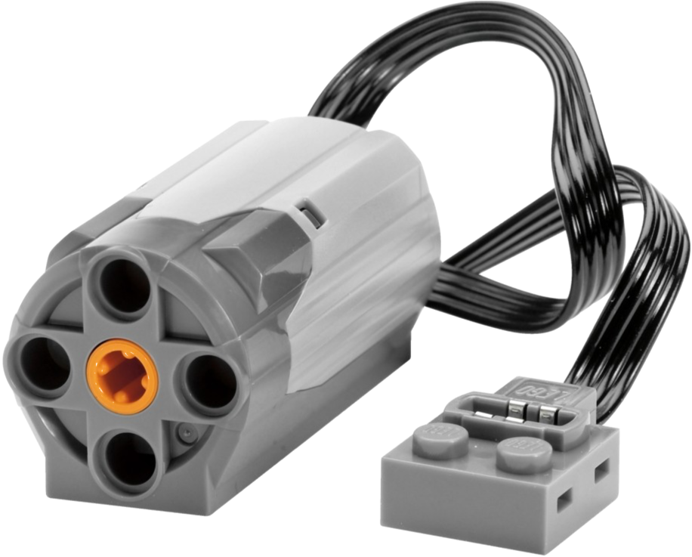
Wiring

Slide 4
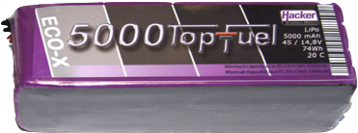
Wiring
VCC
5V
H-Bridge
IN
OUT

Slide 5
Wiring
VCC
5V
H-Bridge
IN
OUT
11.1V

Slide 6
Wiring
VCC
5V
H-Bridge
IN
OUT
11.1V

Slide 7
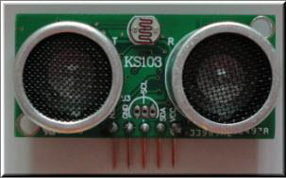
Wiring
VCC
5V
H-Bridge
IN
OUT
11.1V

Slide 8
Wiring
VCC
5V
H-Bridge
IN
OUT
11.1V

Slide 9
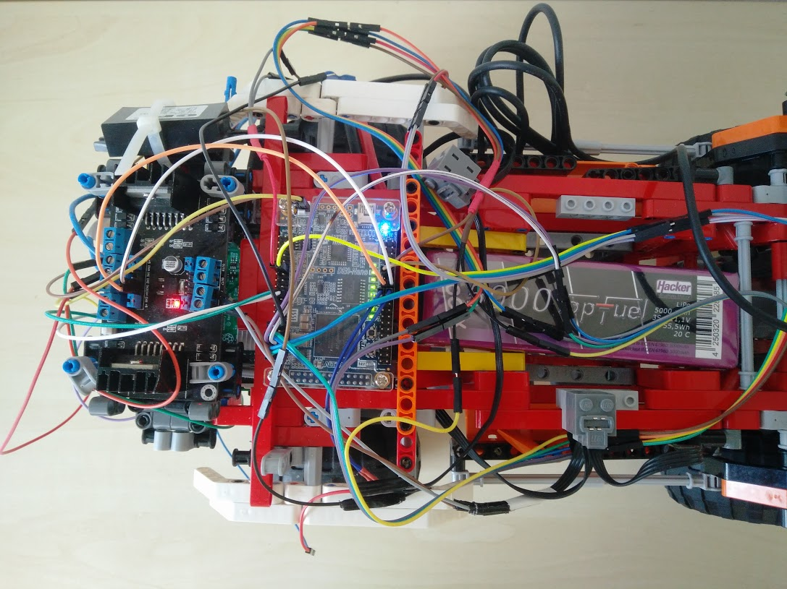
Wiring

Slide 10
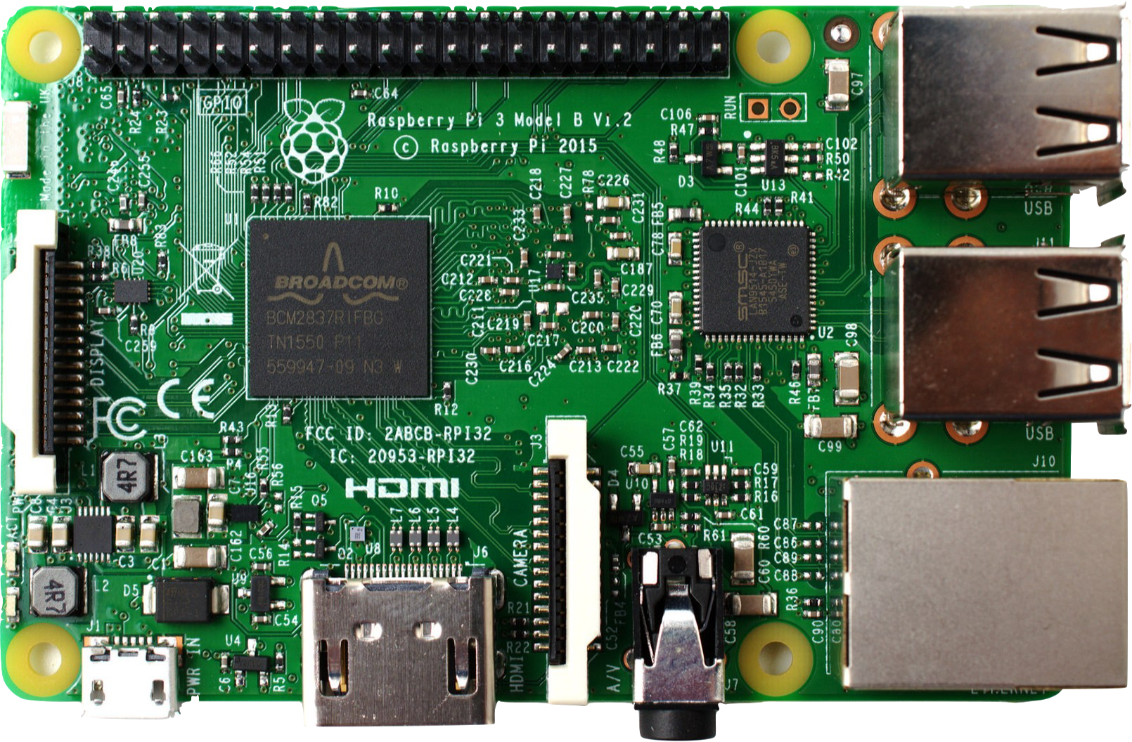
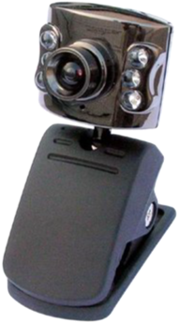
Wiring
VCC
5V
H-Bridge
IN
OUT
11.1V

Slide 11
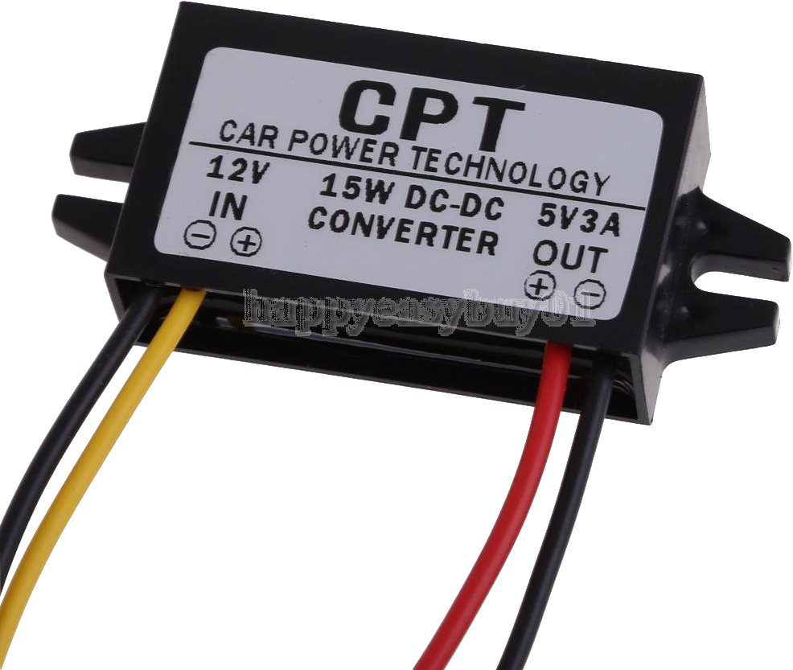
Wiring
VCC
5V
H-Bridge
IN
OUT
11.1V

Slide 12
Wiring
VCC
5V
H-Bridge
IN
OUT
5V
11.1V

Slide 13
Wiring
VCC
5V
H-Bridge
IN
OUT
5V
11.1V

Slide 14
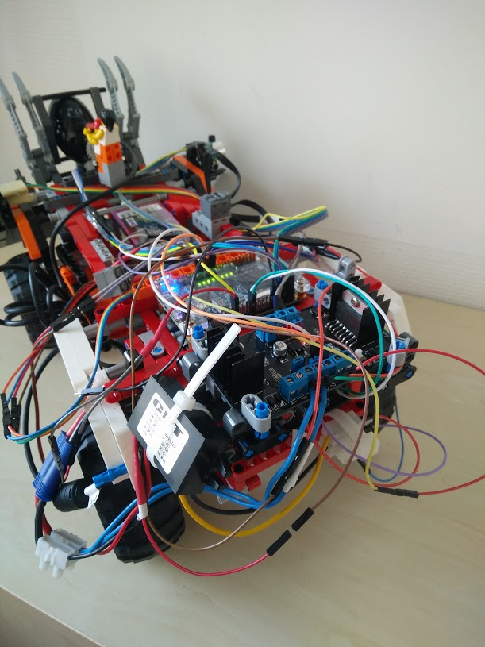
Wiring

